Slide 1
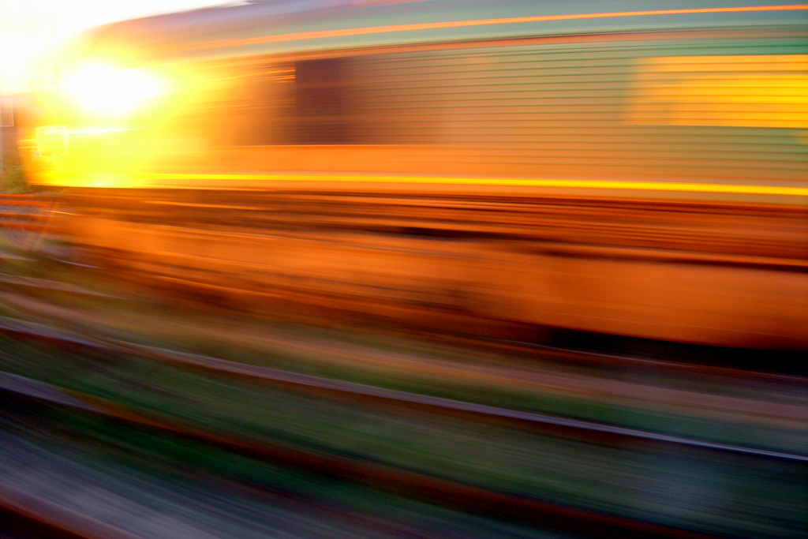


Searching the web
DEPARTMENT OF COMPUTER SCIENCE
CHANGE THE WORLD
Prof. Mark Handley
Notes:
Photo by Ken Douglas, Licensed under creative commons noncommercial, attribution, share alike: http://www.flickr.com/photos/good_day/262455824/

Slide 2
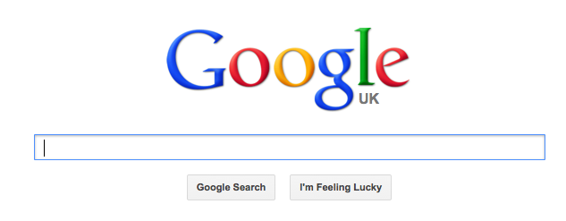
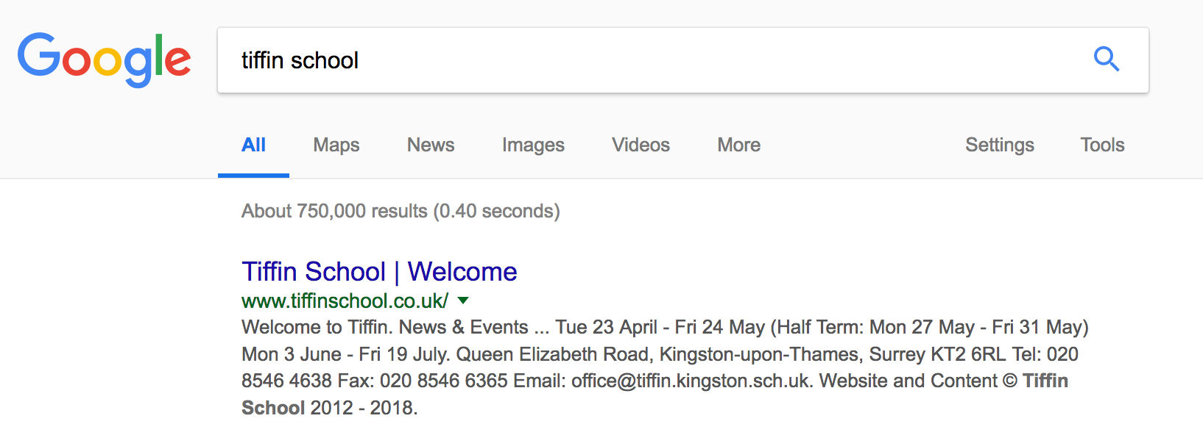
How do they do that?

Slide 3
First, build an index.
Need to download 30 trillion web pages every few days.

Slide 4
A really really big index.
100 million gigabytes.
Need to store the index in memory so it can be searched (disks and flash drives are too slow)

Slide 5
Your query can be any combination of words.
Google doesn’t know in advance which parts of the index will match that combinaton.
Your query must meet the whole index!

Slide 6
100 million gigabytes.

Slide 7
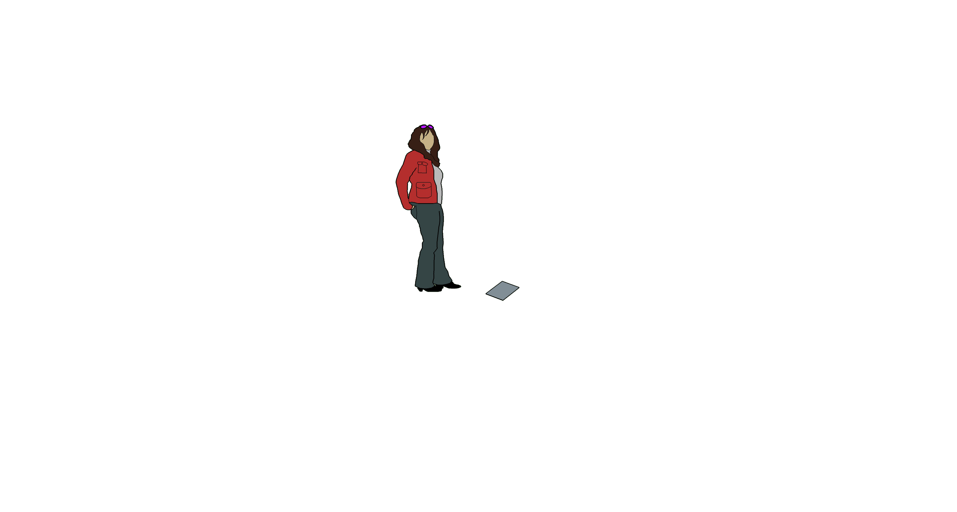
1 printed page
400 words
2400 bytes

Slide 8
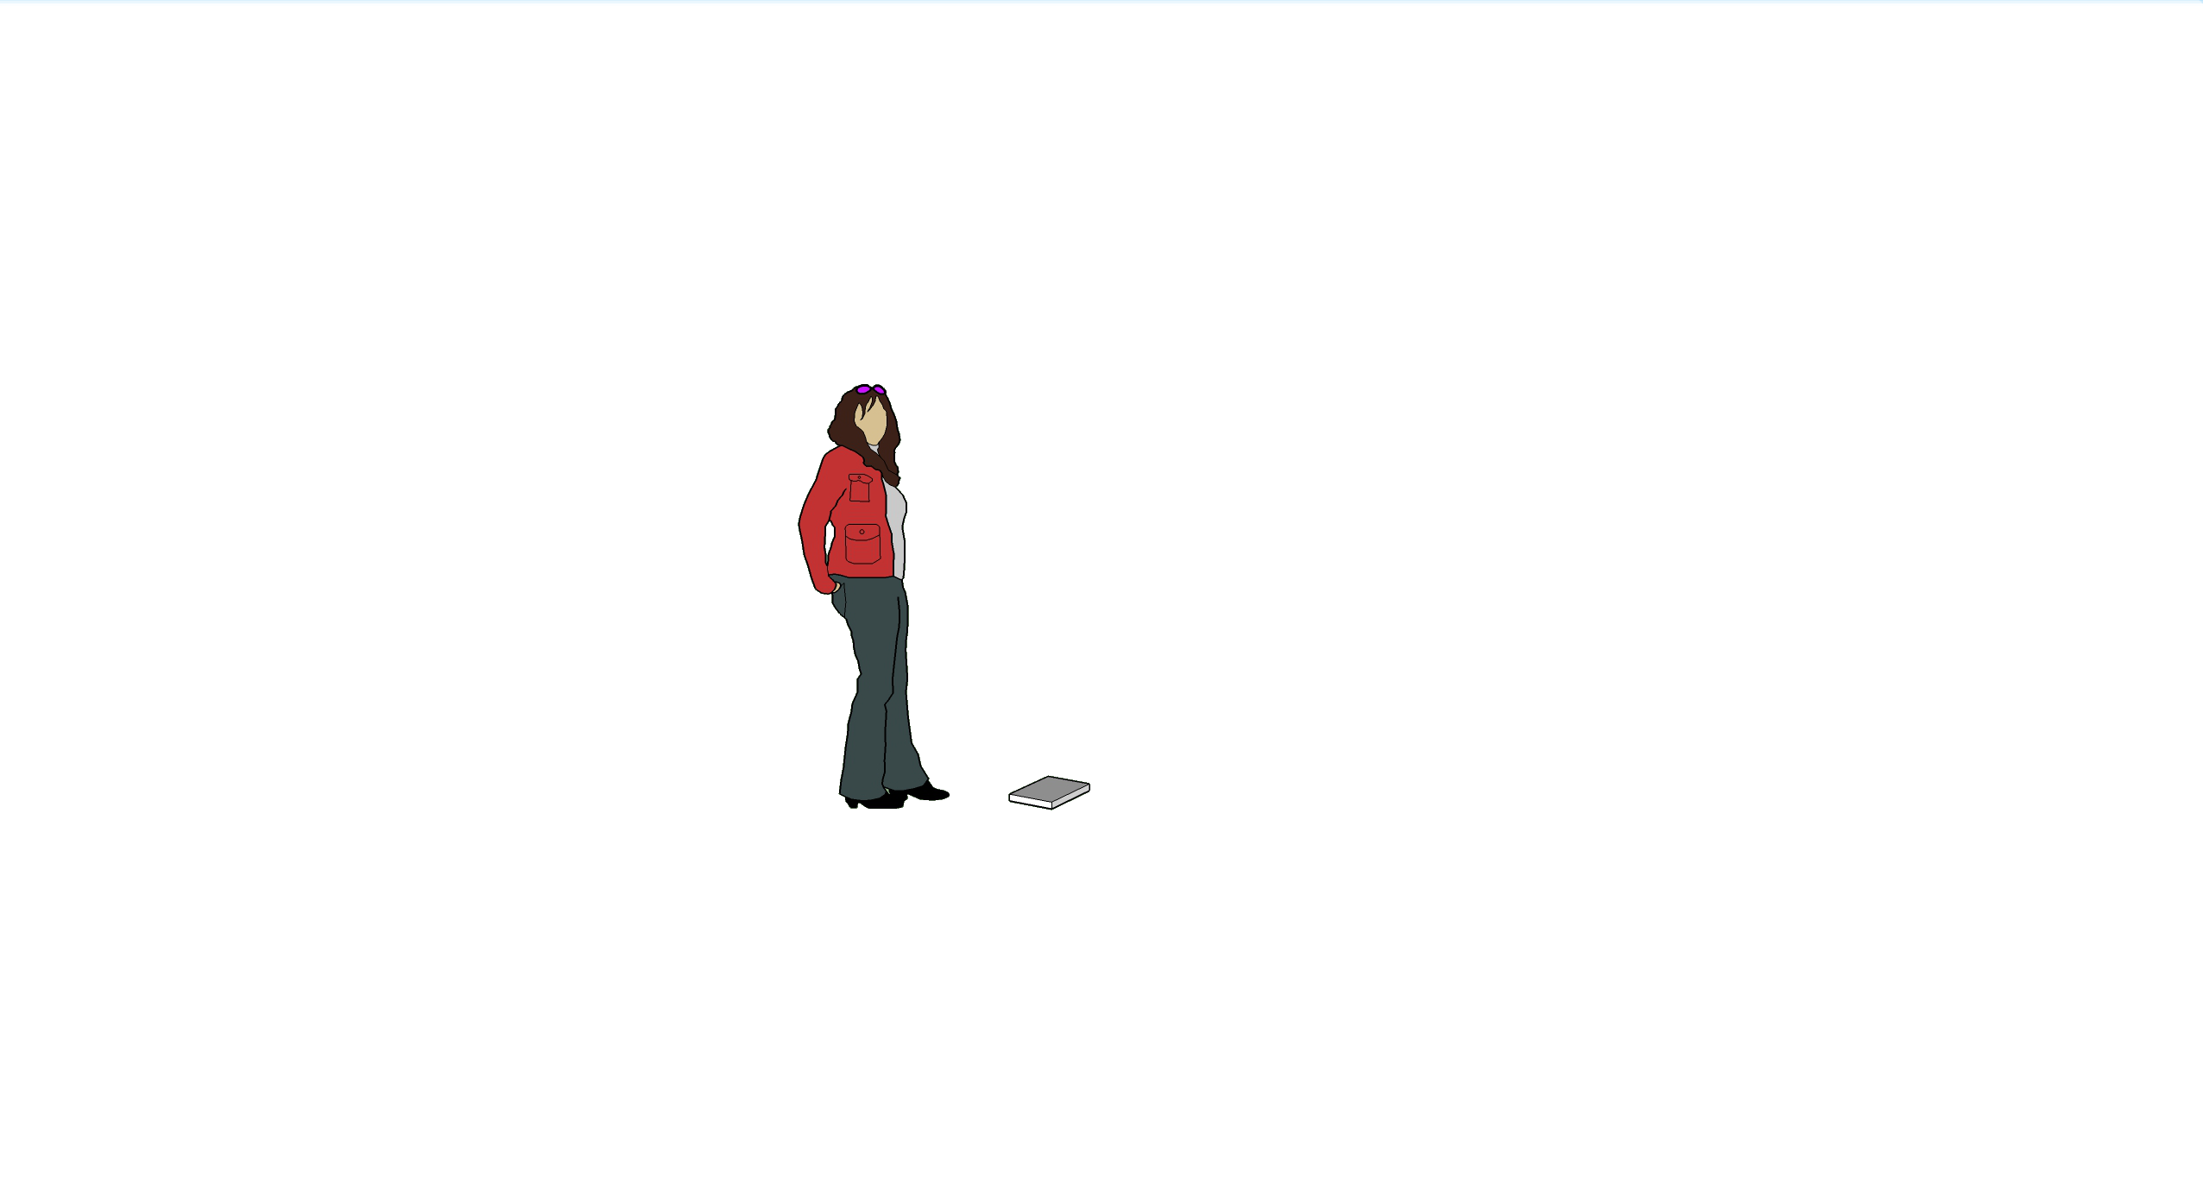
1 book
64,000 words
380,000 bytes

Slide 9
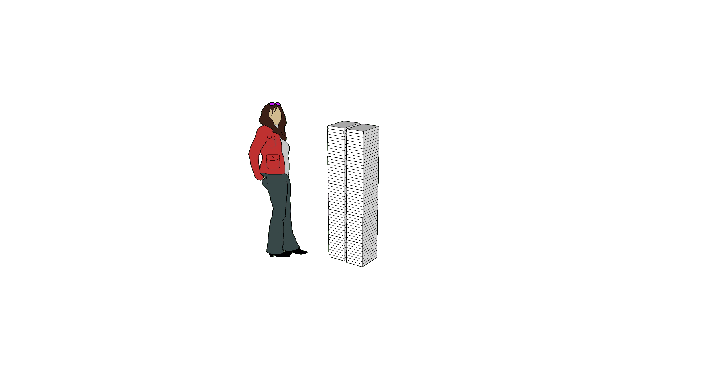
100 books
6,400,000 words
38 megabytes

Slide 10
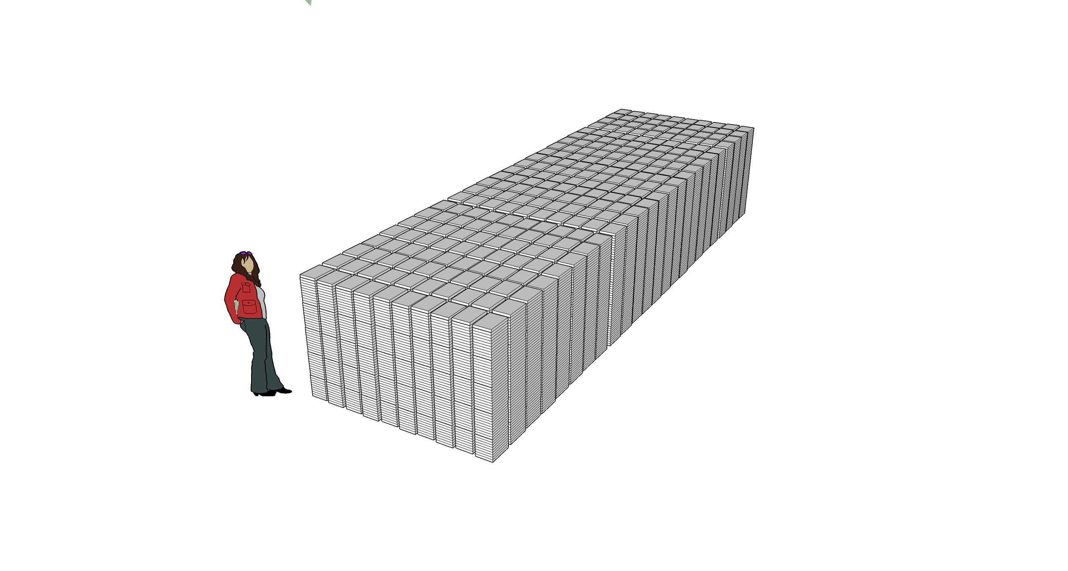
12,000 books
770,000,000 words
4.6 gigabytes

Slide 11
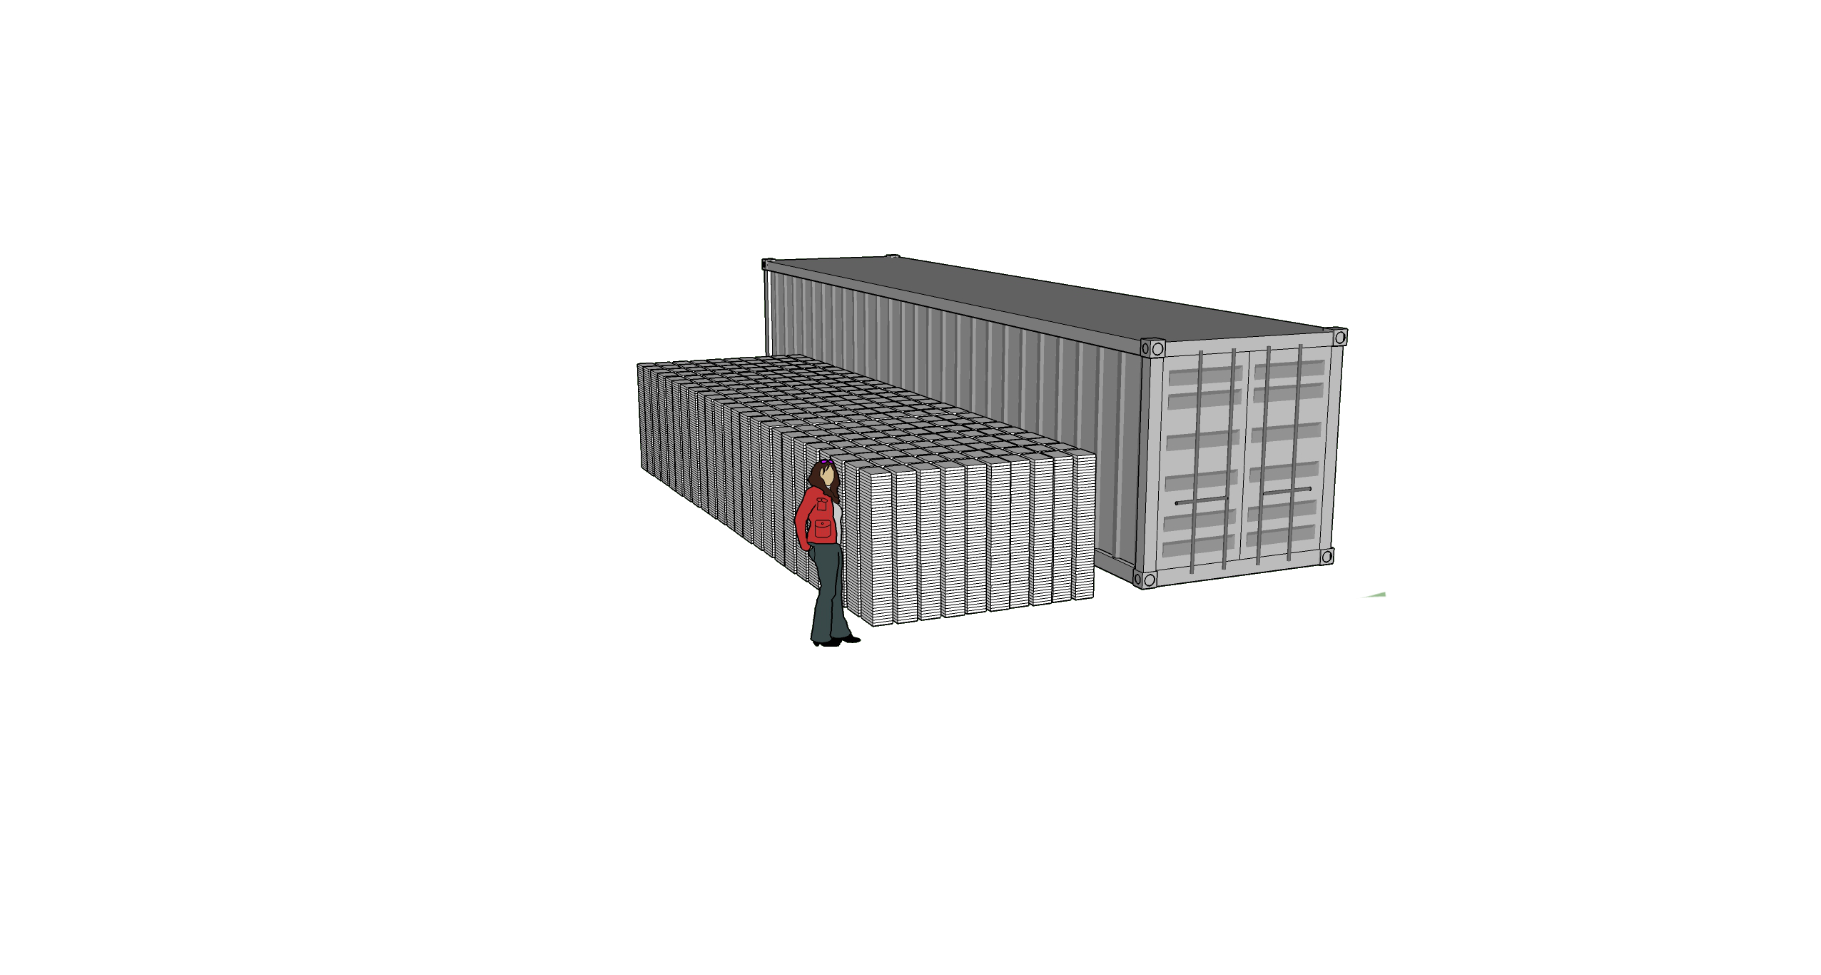
1 shipping container
12,000 books
770,000,000 words
4.6 gigabytes

Slide 12
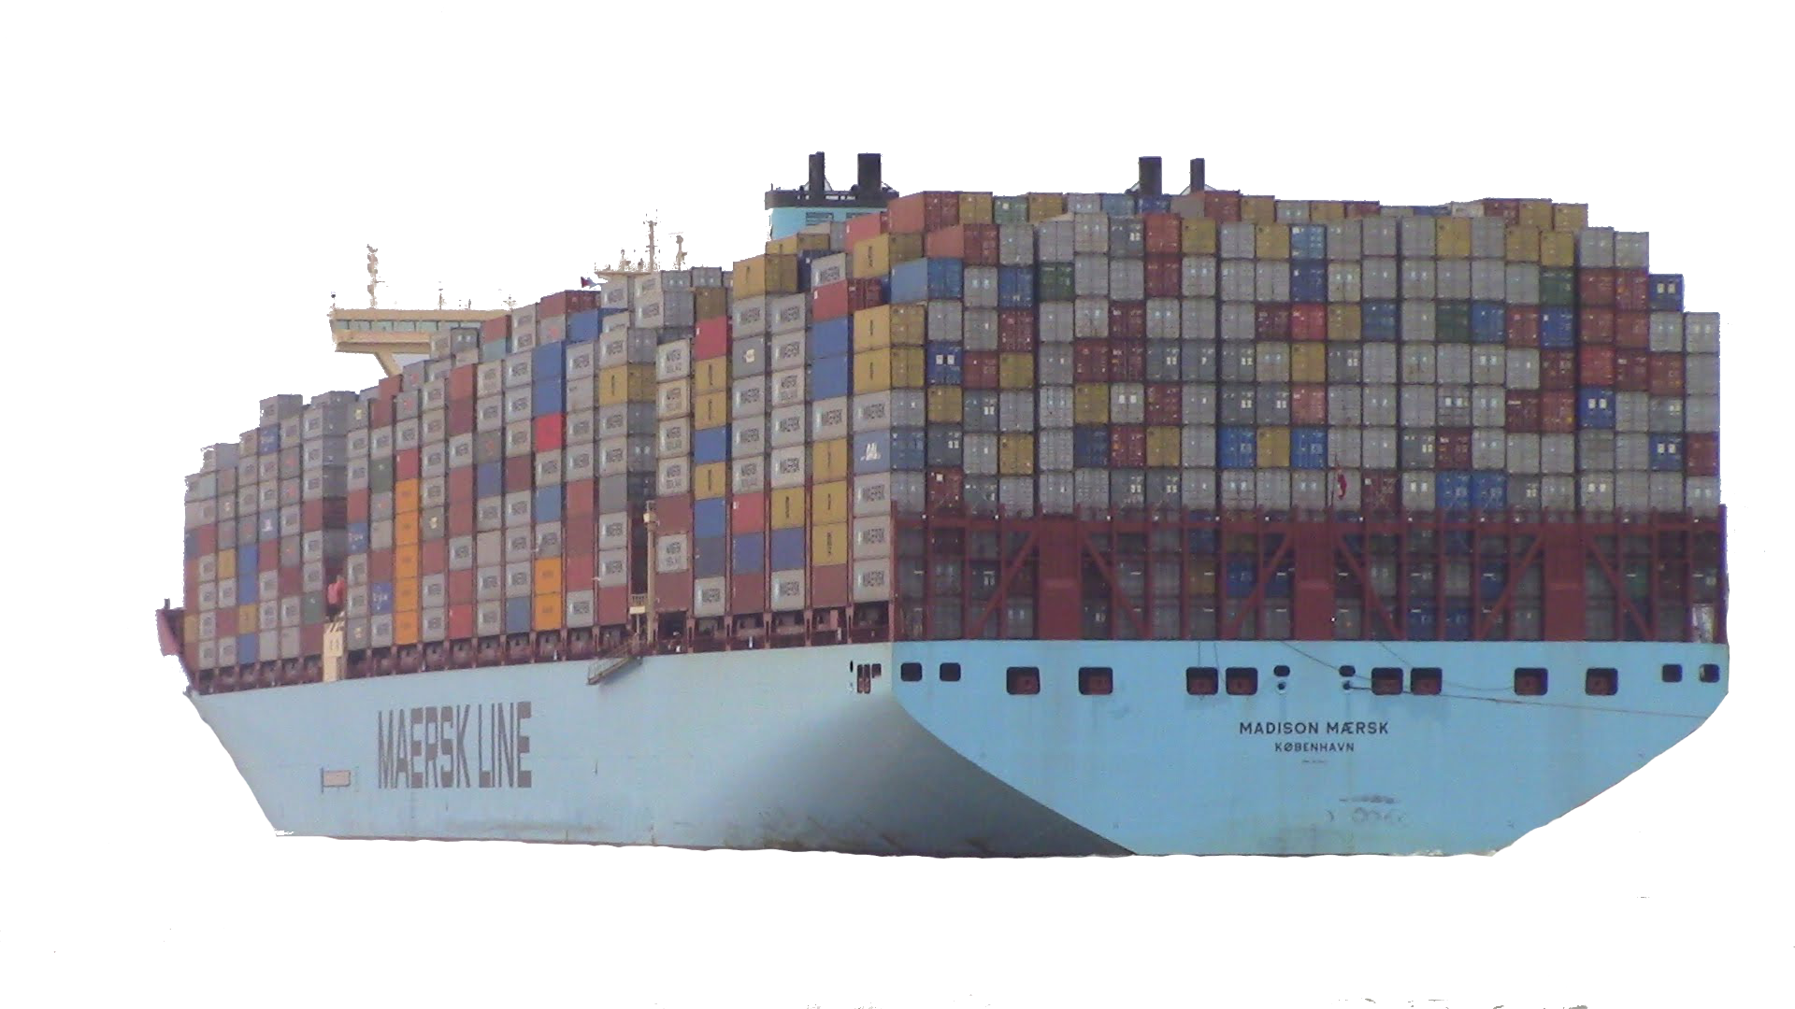
1 ship
18,000 containers
216 million books
14 trillion words
83,000 gigabytes

Slide 13
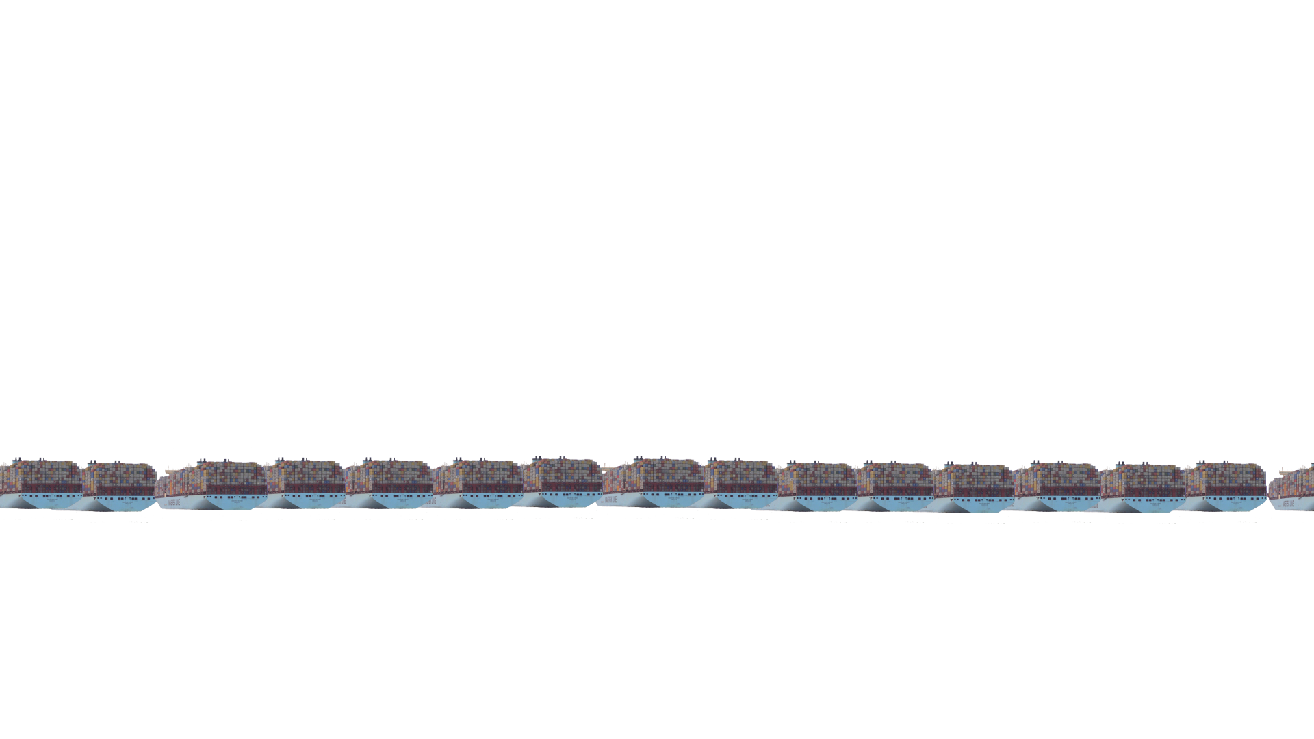
Google Index: 100 million gigabytes.
1 ship = 83,000 gigabytes.
We’re going to need all the world’s ships.

Slide 14
100 million gigabytes.
My phone: 3 gigabytes of RAM
My laptop: 16 gigabytes of RAM
Very high end server: 10,000 gigabytes of RAM
Need 10,000 servers just to hold one copy of the index.

Slide 15
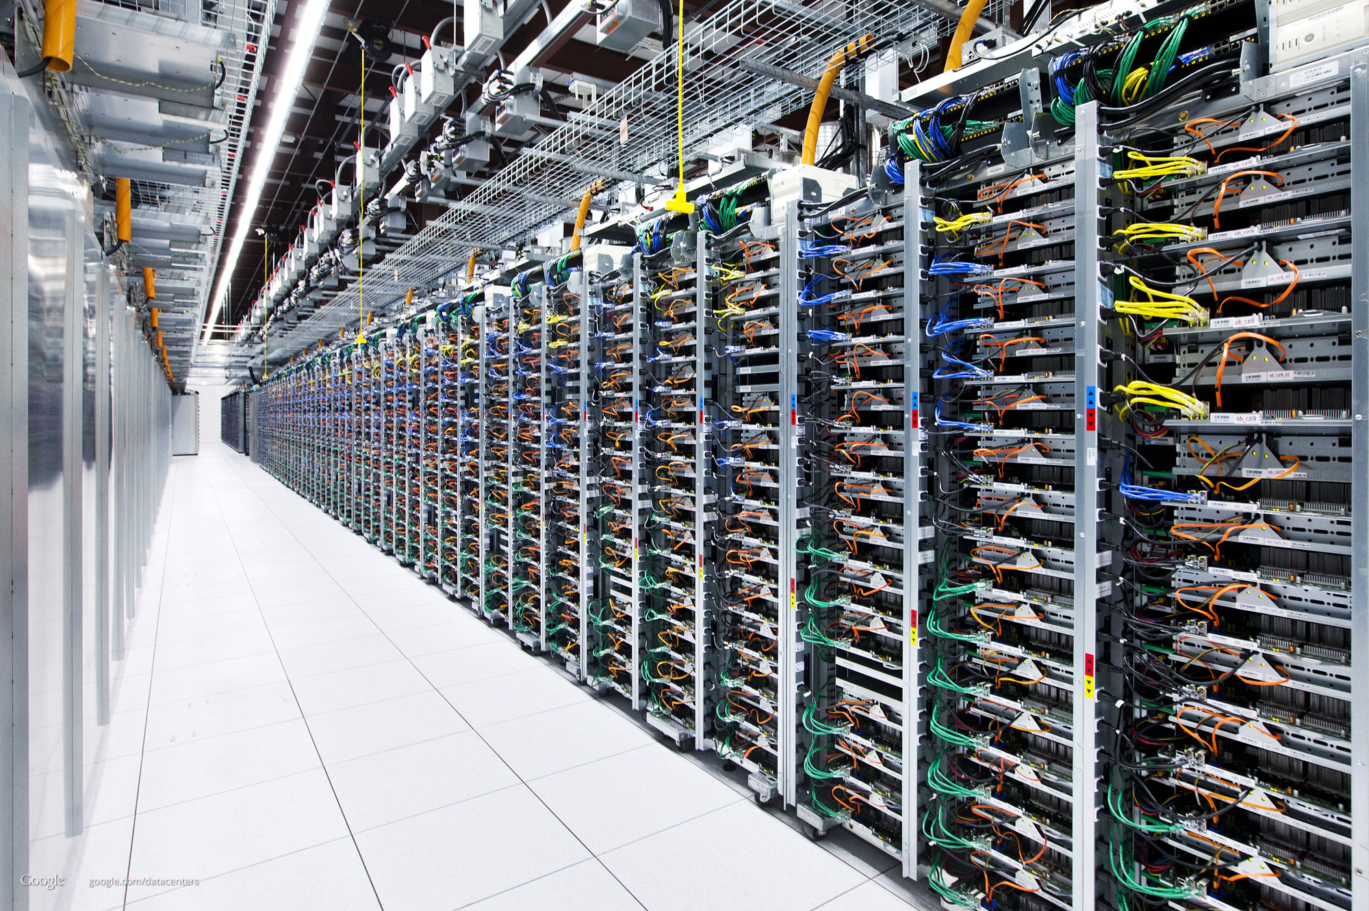

Slide 16
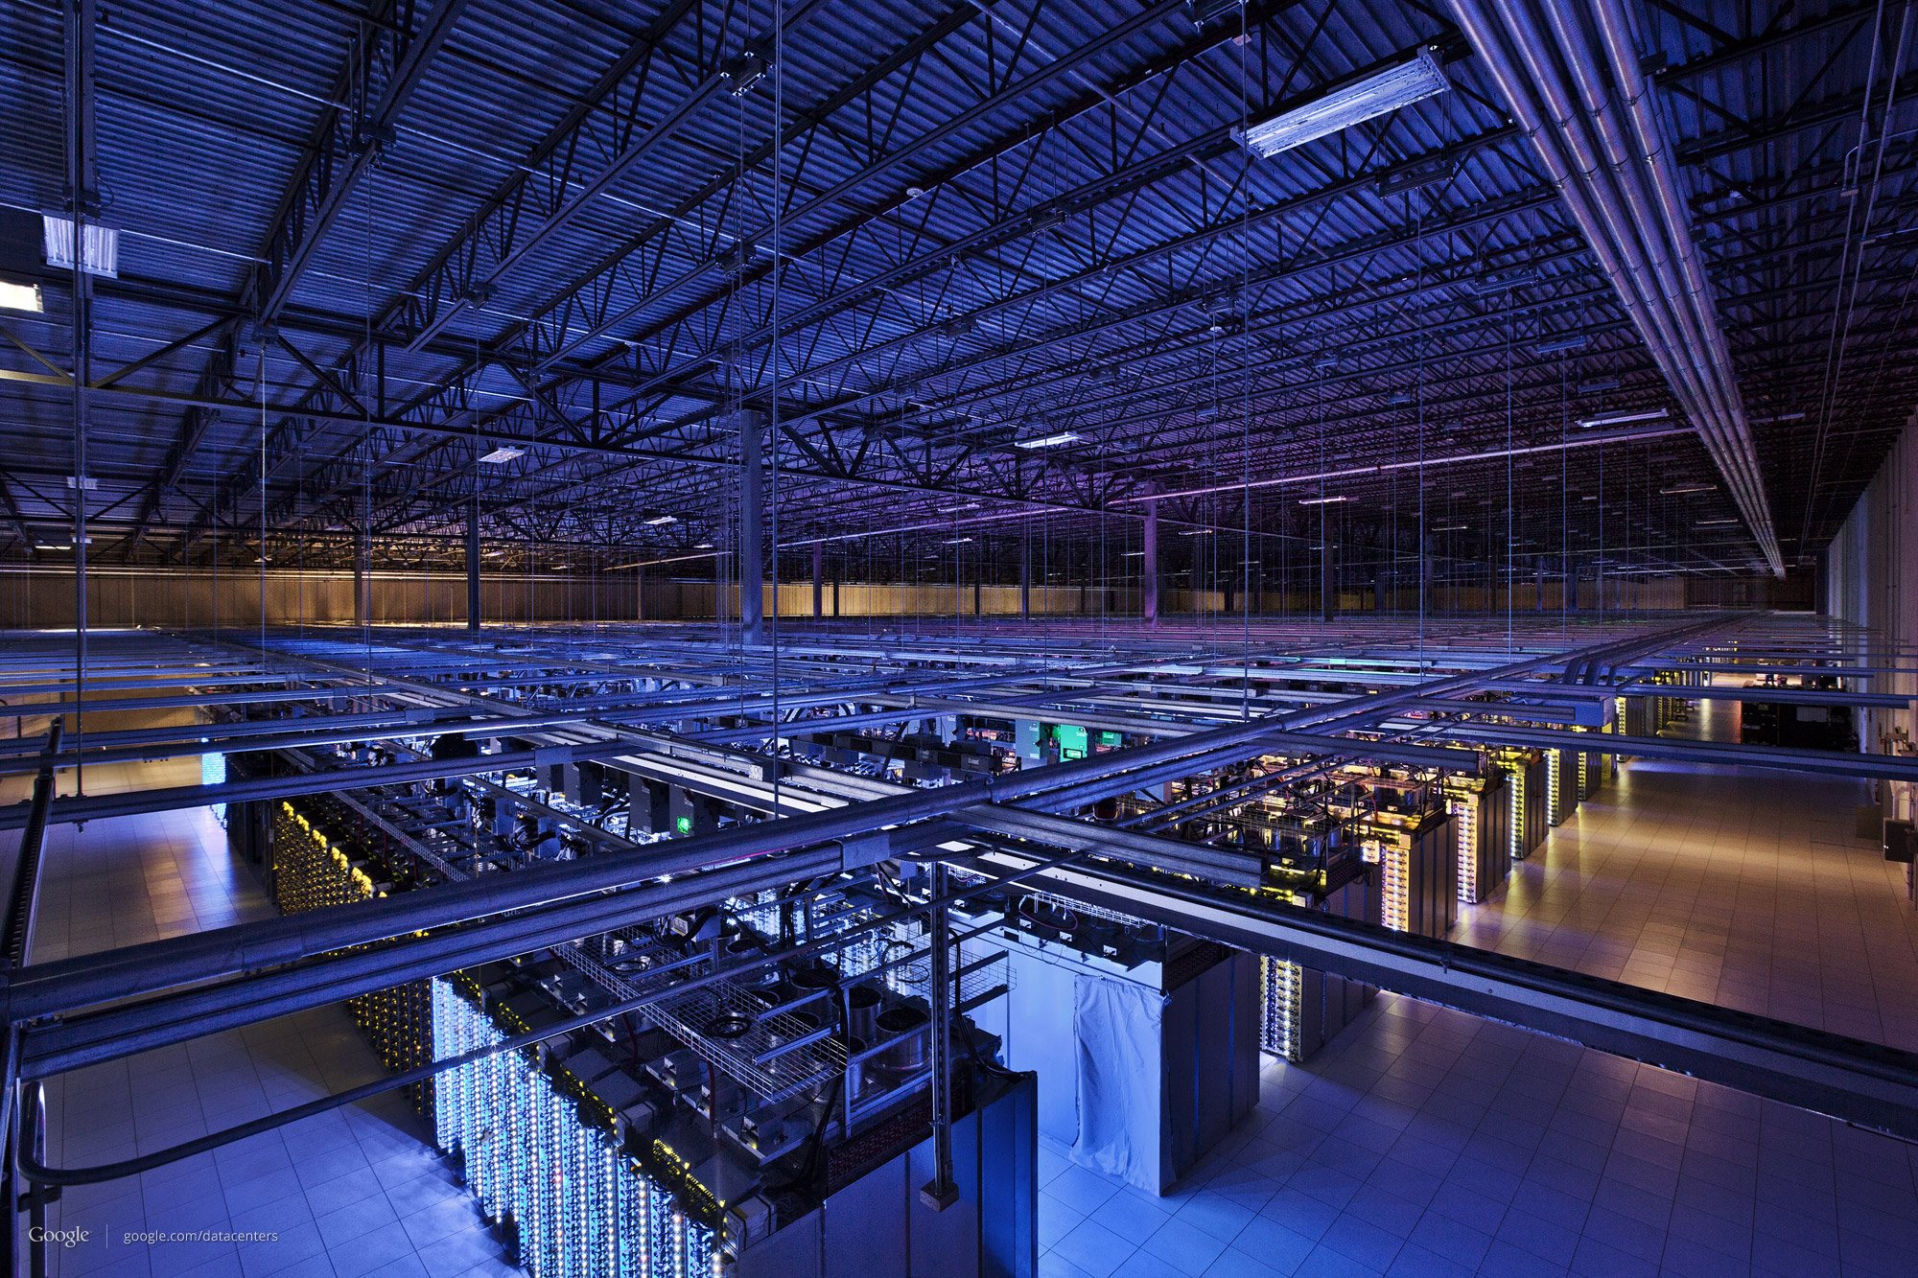

Slide 17
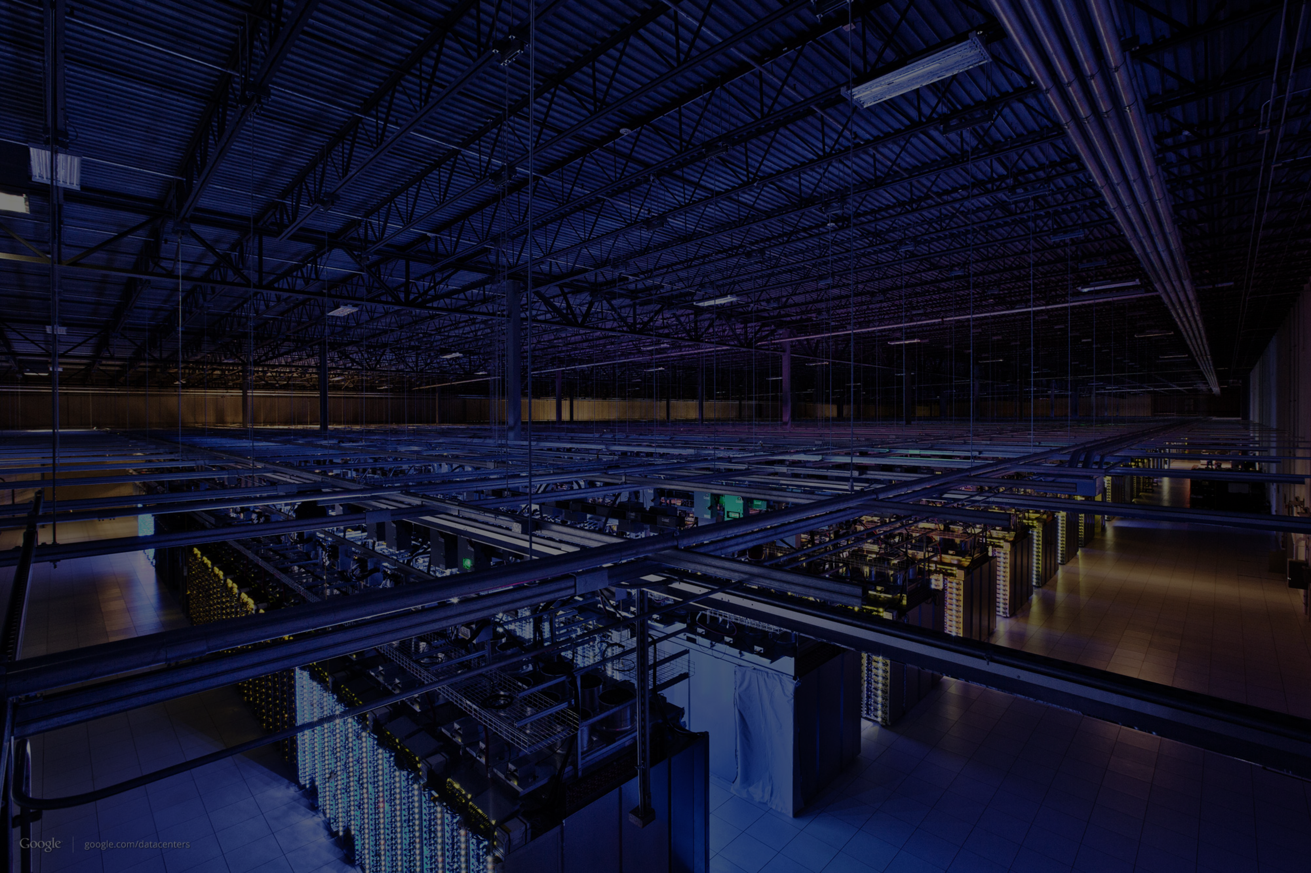

Slide 18
Index
Shard
Divide the index into 10,000 shards.
Each shard indexes 1/10,000th of the Internet.
One server per shard.
Shard
Shard
Shard
Shard
Shard

Slide 19
Index
Shard
Divide the index into 10,000 shards.
Each shard indexes 1/10,000th of the Internet.
One server per shard.
Shard
Shard
Shard
Shard
Shard

Slide 20
Shard 10,000
Server
Shard 9,999
Server
Shard 9,998
Server
Shard 3
Server
Shard 2
Server
Shard 1
Server

Slide 21
Shard 10,000
Server
Server
Server
Server
Server
Server
Server
Server
Server
Shard 9,999
Server
Server
Server
Server
Server
Server
Server
Server
Server
Shard 9,998
Server
Server
Server
Server
Server
Server
Server
Server
Server
Shard 3
Server
Server
Server
Server
Server
Server
Server
Server
Server
Shard 2
Server
Server
Server
Server
Server
Server
Server
Server
Server
Shard 1
Server
Server
Server
Server
Server
Server
Server
Server
Server

Slide 22
Shard 10,000
Server
Server
Server
Server
Server
Server
Server
Server
Server
Server
Shard 9,999
Server
Server
Server
Server
Server
Server
Server
Server
Server
Server
Shard 9,998
Server
Server
Server
Server
Server
Server
Server
Server
Server
Server
Shard 3
Server
Server
Server
Server
Server
Server
Server
Server
Server
Server
Shard 2
Server
Server
Server
Server
Server
Server
Server
Server
Server
Server
Shard 1
Server
Server
Server
Server
Server
Server
Server
Server
Server
Server
Query must be sent to one server from every shard
Results from each server are merges and ranked to create your answer
Your query
Each server searches the index for its part of the web
Your answer

Slide 23
When you search on Google, 10,000 servers each run your search on part of the index of 30 trillion web pages.
Other servers merge the answers and rank them.
You get a result in less than a second.

